Slide 1
How to Support your Immune System
Pam Horton, RD, IBCLC
Marion County Public Health Department
Whitney Schaefer
Dietetic Intern
Ball State University
Notes:
You’re practicing social distancing. You’ve become a model for good hand hygiene. And you’re keeping those hands away from your face. But you’re probably wondering if there are things you should be doing to support your immunity as well. Healthy lifestyle habits are the best way to support a healthy immune system.

Slide 2
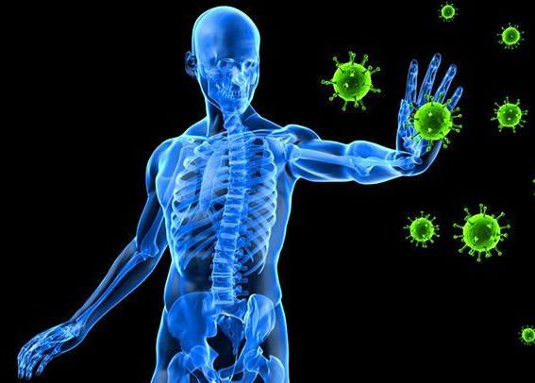
Immune System
Helps defend the body against infections
Identifies every germ so it can recognize and destroy it quickly and remember it if it enter the body again
Infections like the flu and common cold must be fought many times since there are many different viruses or strains of the same type of virus
Notes:
Let’s review what the function of our immune system is. Basically it is to defend against invaders.

Slide 3
Parts of Immune System
White Blood Cells
Antibodies
Lymphatic system
Spleen
Bone marrow
Thymus
Notes:
Your immune system is a large network of organs, white blood cells, (antibodies) and chemicals. This system works together to protect you from foreign invaders (bacteria, viruses, parasites, and fungi) that cause infection, illness and disease.

Slide 4
Immune System Supporters
Notes:
“Boosting” the Immune System
Even if we could boost our immunity, it would likely be a bad idea since a “boosted” immune system would mean it’s working in overdrive – and that is often synonymous with inflammation and autoimmune disease.
However, it does make pragmatic sense to engage in healthy behaviors to support your health and immune function during this pandemic. Our body needs many nutrients in adequate amounts to support our daily functions, including those that help our immune system work properly and help protect us against many diseases.
Conversely, some specific nutrient deficiencies can impair our immune system.

Slide 5
Vitamins and Minerals

Slide 6
Vitamin C
Strawberries, raspberries, blackberries, oranges, tomatoes, kale, broccoli, kiwi, bell peppers
Antioxidant that protects against cell damage and can help reduce the duration and severity of upper respiratory tract infections
Notes:
I’m sure you all have heard the term antioxidant. But what exaclty is an antioxidant. Antioxidants are substances that can prevent or slow damage to cells caused by free radicals, unstable molecules produced by cells as the body processes food and reacts to the environment. If the body cannot process and remove free radicals efficiently, oxidative stress can result. This can harm cells and body function.

Slide 7
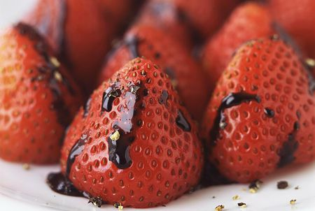
Strawberries with reduced balsamic vinegar

Slide 8
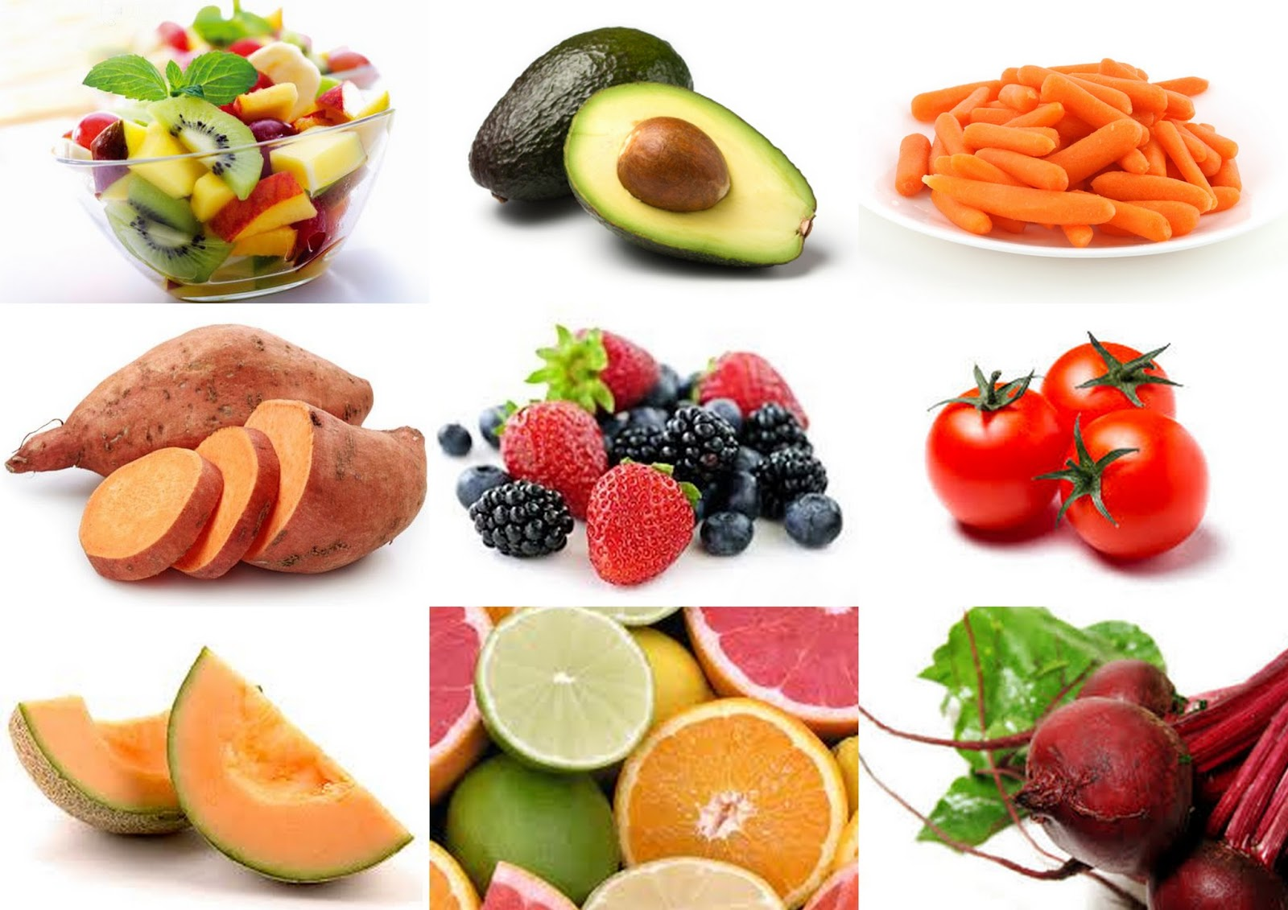
Vitamin A
Sweet potato, carrots, spinach, broccoli, red pepper, pumpkin, mango, cantaloupe
Known as an anti-inflammatory vitamin
Notes:
Inflammation is another word you may hear often. Let’s review what it means.
Inflammation , which is part of the body’s natural healing system, helps fight injury and infection. But it doesn’t just happen in response to injury and illness.
An inflammatory response can also occur when the immune system goes into action without an injury or infection to fight. Since there’s nothing to heal, the immune system cells that normally protect us begin to destroy healthy arteries, organs and joints.
When you don’t eat healthy, don’t get enough exercise, or have too much stress, the body responds by triggering inflammation. Chronic inflammation can have damaging consequences over the long term. So the food you eat, the quality of sleep you get and how much you exercise, they all really matter when it comes to reducing inflammation.
epithelium (outer surfaces of the body and sking)

Slide 9
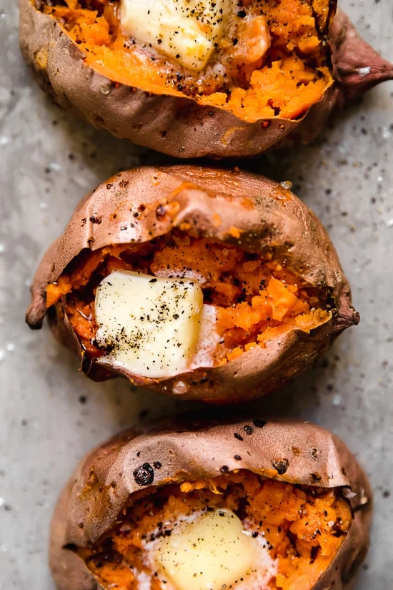
Roasted sweet potatoes

Slide 10
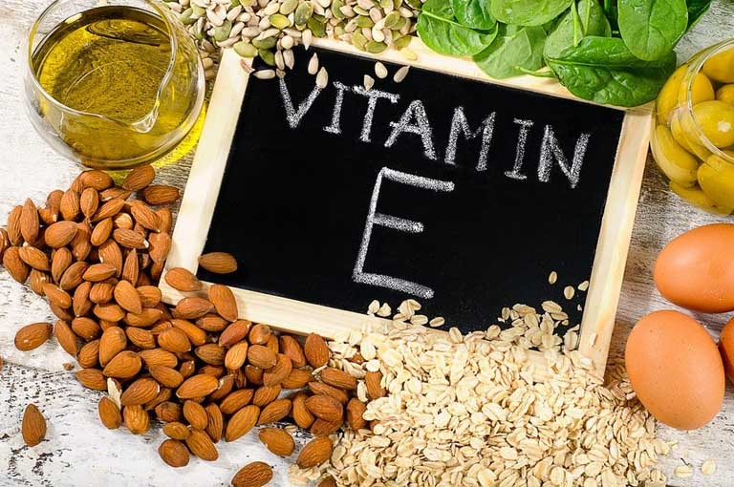
Vitamin E
Nuts (almonds, peanuts, hazelnuts), vegetable oils, sunflower seeds, green leafy vegetables
Powerful antioxidant that helps protect T-cells
Notes:
Whenever a virus or other pathogen enters our bodies, a certain class of immune cells—the T cells—jump into action, proliferating rapidly.
Oxidative stress can damage t cells

Slide 11
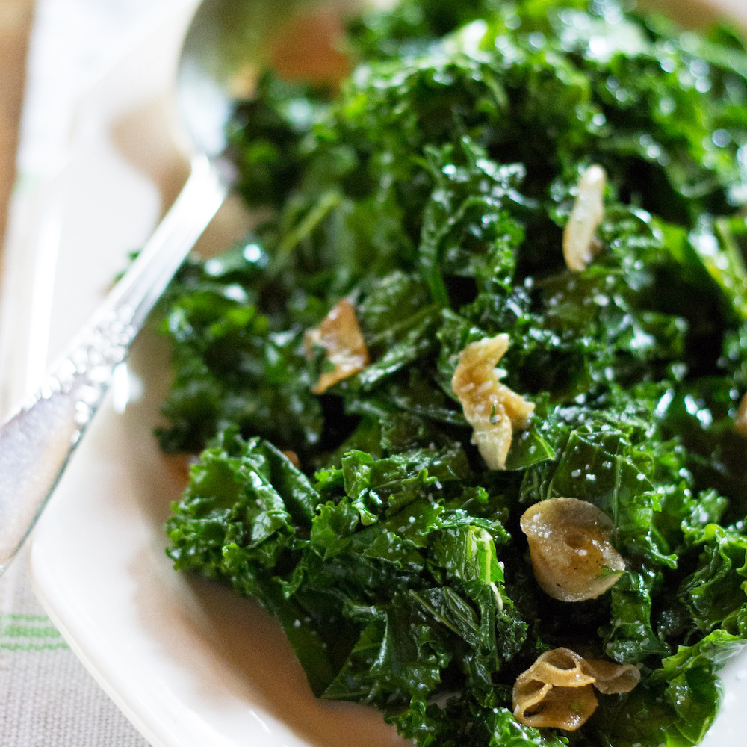
Sauteed Kale

Slide 12
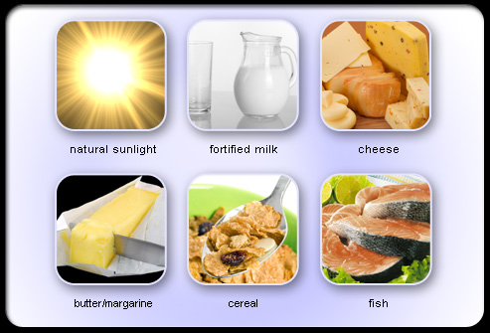
Vitamin D
Tuna, salmon, milk, cheese, egg yolks, sardines
Fat soluble vitamin that enhances the pathogen-fighting effects of macrophages
Important parts of immune defense and helps decrease inflammation
This Photo by Unknown Author is licensed under CC BY-SA
Notes:
Vitamin D deficiency is very common.
Supplementation is not a bad idea. 400-800 IU

Slide 13
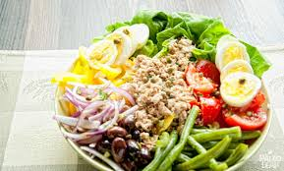
Easy Nicoise Salad

Slide 14
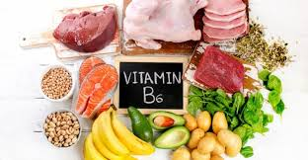
Vitamin B6
Pork, poultry, fish, bread, whole grain cereals, eggs, soybeans, chickpeas
Deficiency of this vitamin has been associated suppression of lymphocytes
Notes:
Vitamin B6 Promotes lymphocyte production Lymphocytes are white blood cells that are also one of the body's main types of immune cells

Slide 15
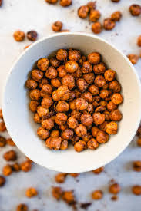
RoastedChickpeas

Slide 16
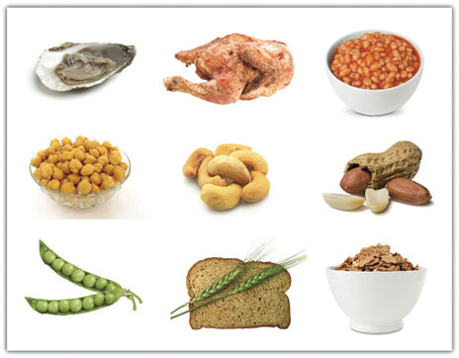
Zinc
Whole grains, milk products, breakfast cereals, oysters, red meat, poultry, baked beans, and nuts
Needed for immune cell development and plays an important role in inflammatory response
Notes:
Zinc is found in cells throughout the body. It helps the immune system fight off invading bacteria and viruses.

Slide 17
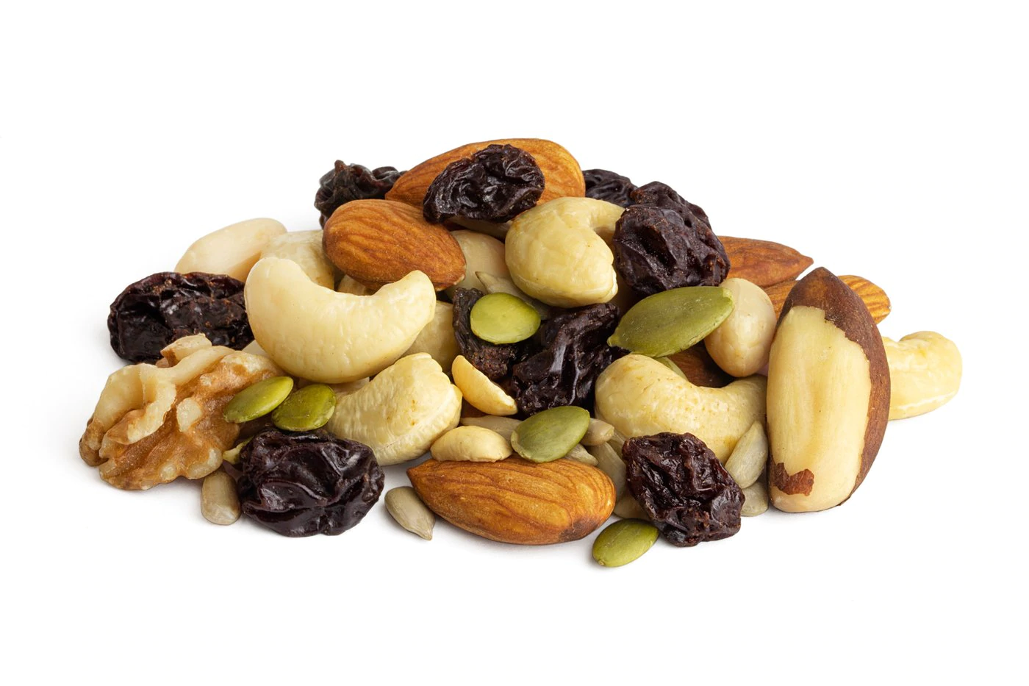
Make your own trail mix

Slide 18
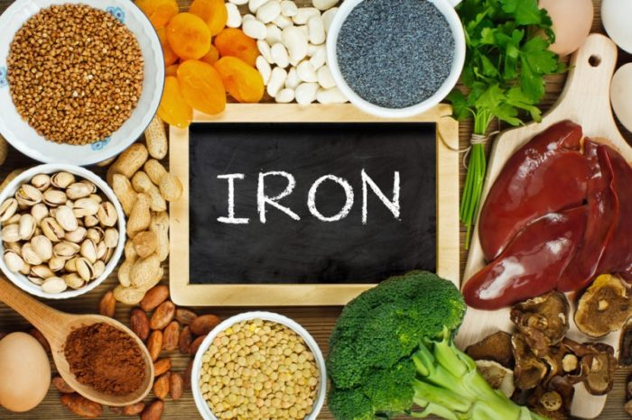
Iron
Fortified breakfast cereals, cooked oysters, white beans, dark chocolate, red meat, lentils, spinach
Iron Immunity helps immune cells proliferate and mature
Notes:
Vitamin c and iron.

Slide 19
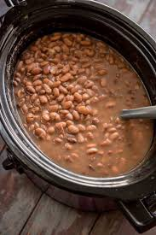
Crockpot beans

Slide 20
Beyond Food
Notes:
Minimizing stress

Slide 21
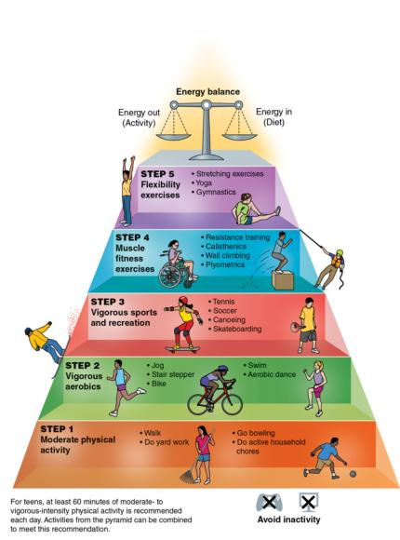
Exercise
30-60 minutes of daily exercise
Improves cardiovascular health
Lowers blood pressure
Maintain weight
Protect against diseases

Slide 22
Non-Smoking
Smoking may weaken the immune system
This Photo by Unknown Author is licensed under CC BY
Notes:
Smoking is bad for a million reasons one of which is an impaired immune system. Damages lungs are more susceptible to infection. In addition, nicotine is known to be immunosuppressive that can lead to decreased phagocytic activity.

Slide 23
Alcohol Moderation
Association between excessive alcohol consumption and adverse immune-related health effects such as susceptibility to pneumonia.
Notes:
What is moderate drinking

Slide 24
Adequate Sleep
Immune system releases proteins called cytokines, some of which help promote sleep.
Certain cytokines need to increase when you have an infection or inflammation, or when you're under stress.
Sleep deprivation may decrease production protective cytokines.
Notes:
lack of sleep can affect your immune system. Studies show that people who don't get quality sleep or enough sleep are more likely to get sick after being exposed to a virus, such as a common cold virus. Lack of sleep can also affect how fast you recover if you do get sick.
During sleep, your immune system releases proteins called cytokines, some of which help promote sleep. Certain cytokines need to increase when you have an infection or inflammation, or when you're under stress. Sleep deprivation may decrease production of these protective cytokines. In addition, infection-fighting antibodies and cells are reduced during periods when you don't get enough sleep.

Slide 25
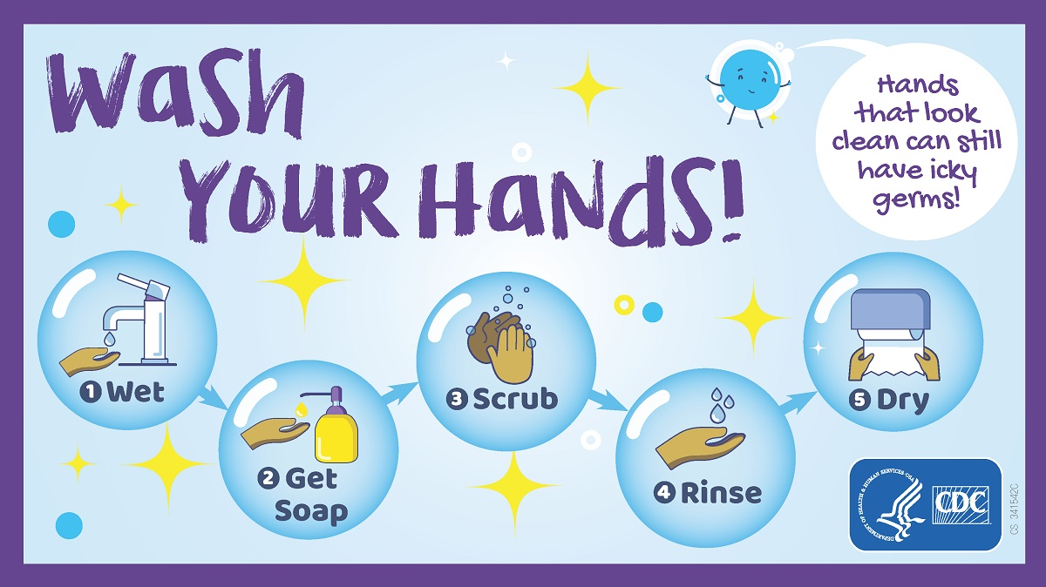
Proper Handwashing
Wet your hands with clean, running water (warm or cold)
Turn off the tap and apply soap
Lather your hands by rubbing them together with the soap.
Lather the backs of your hands, between your fingers, and under your nails.
Scrub your hands for at least 20 seconds.
Rinse your hands well under clean, running water.
Dry your hands using a clean towel or air dry them.

Slide 26
Minimizing Stress
Relaxation techniques:
Deep breaths
Muscle relaxation
Mindfulness meditation
Yoga and tai chi
Repetitive prayer
Guided Imagery
Ask for help when needed or overwhelmed
Notes:
When we’re stressed, the immune system’s ability to fight off invaders is reduced. That is why we are more susceptible to infections.
The stress hormone corticosteroid can suppress the effectiveness of the immune system (e.g. lowers the number of lymphocytes).
Limit the amount of news you consume. Engage in a random act of kindness. Stay engaged with friends and family virtually. When you get in bed think of 3 things you are grateful for.

Slide 27
Questions?

Slide 28
Thank you ☺

Slide 29
Resources
Albin, J. (2020, April). Quarantine cuisine: Easy meals to support a healthy immune system: COVID: Prevention: UT Southwestern Medical Center. Retrieved June 16, 2020, from https://utswmed.org/medblog/easy-immune-boosting-food-covid19/
Center for Disease Control and Prevention. (2020, April 02). When and How to Wash Your Hands. Retrieved June 16, 2020, from https://www.cdc.gov/handwashing/when-how-handwashing.html
Department of Health & Human Services. (2014, March 30). Immune system. Retrieved from https://www.betterhealth.vic.gov.au/health/conditionsandtreatments/immune-system
Harvard Health Publishing. (2014). How to boost your immune system. Retrieved June 16, 2020, from https://www.health.harvard.edu/staying-healthy/how-to-boost-your-immune-system
Huang, Z., Liu, Y., Qi, G., Brand, D., & Zheng, S. (2018, September 6). Role of Vitamin A in the Immune System. Retrieved June 16, 2020, from https://www.ncbi.nlm.nih.gov/pmc/articles/PMC6162863/
Lee, G., & Han, S. (2018, November 1). The Role of Vitamin E in Immunity. Retrieved June 16, 2020, from https://www.ncbi.nlm.nih.gov/pmc/articles/PMC6266234/
Meydani, R. (1993). Vitamin B6 and Immune Competence. Retrieved June 16, 2020, from https://pubmed.ncbi.nlm.nih.gov/8302491/
National Institutes of Health. (2007). Office of Dietary Supplements - Zinc. Retrieved June 16, 2020, from https://ods.od.nih.gov/factsheets/Zinc-HealthProfessional/
Sarkar, D., Jung, M., & Wang, H. (2015). Alcohol and the Immune System. Retrieved June 16, 2020, from https://www.ncbi.nlm.nih.gov/pmc/articles/PMC4590612/
Harvard Health Publishing. (2010). Relaxation techniques: Breath control helps quell errant stress response. Retrieved June 16, 2020, from https://www.health.harvard.edu/mind-and-mood/relaxation-techniques-breath-control-helps-quell-errant-stress-response

